Slide 1
Introduction to R
Ramsy Agha

Slide 2
Content
about R and RStudio
data handling:
data collection and organization
manipulation and analysis
visualisation
interpretation and presentation

Slide 3
Goals and purposes with using R
powerful, flexible/customizable
easy for sharing and developing
reproducible science: scripts and markdowns

Slide 4
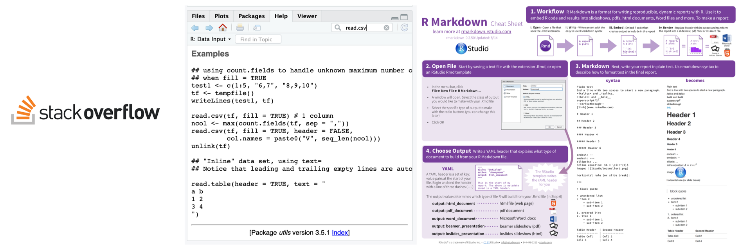
R help & the comunity
Stackoverflow
“man” pages and examples
cheat sheets

Slide 5
Data handling: collecting and organisation
Conventions about data format
Observations are entered in rows
Variables are entered in columns
A column of data should contain only one data type

Slide 6
Data handling: collecting and organisation
Best practice
Store a copy of data in nonproprietary formats
Leave an uncorrected file when doing analyses
Maintain effective metadata about the data
Create folders for relevant task to keep the overview over your analyses

Slide 7
Error messages
Warnings should be acknowledged but can be ignored.
Specific hint? e.g.
wrong data format, characters/factors instead of numbers
library not loaded, package not installed
Try running example code, and check the example input
Google is your friend

Slide 8
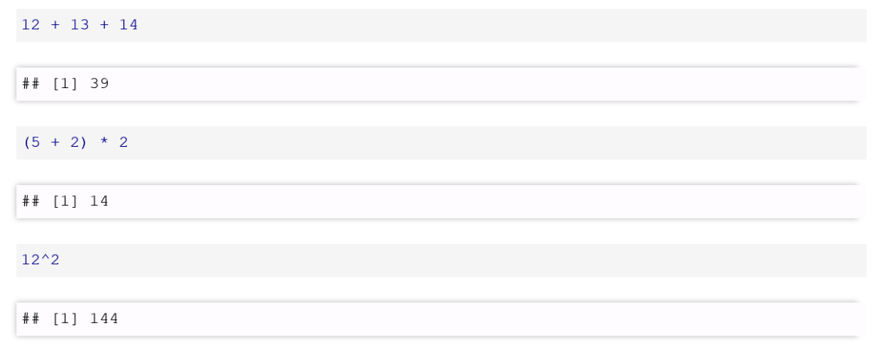
Getting started
How R works: Operators
Arithmetic (basic math): +, -, *, /, ^, …

Slide 9
Getting started
How R works: Operators
Arithmetic (basic math): '+' '-' '*' '/' '^' etc.
Relational: '<' '>' '==' '!=‘
Logical: '!' '&' '&&' '|' '||’
Assignment: '<-' '='

Slide 10
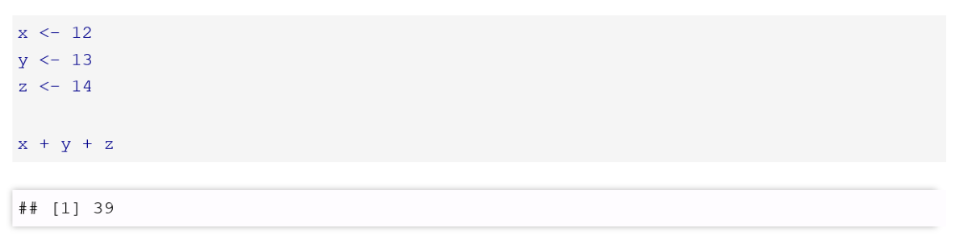
Getting started
Assignment operators : '<-’ '='

Slide 11
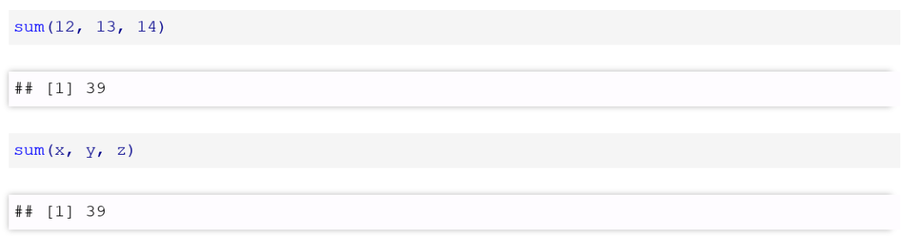
How R works: Functions
function(data, additional arguments)

Slide 12
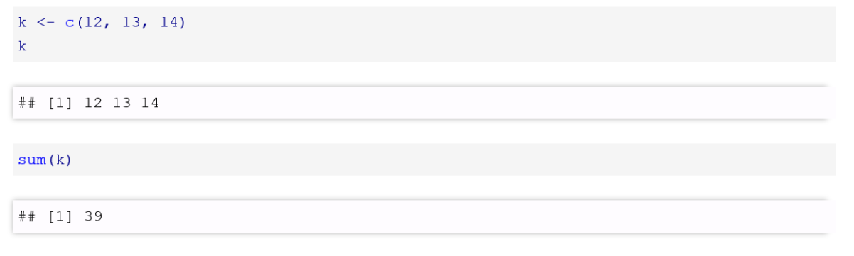
How R works: Putting it all together

Slide 13
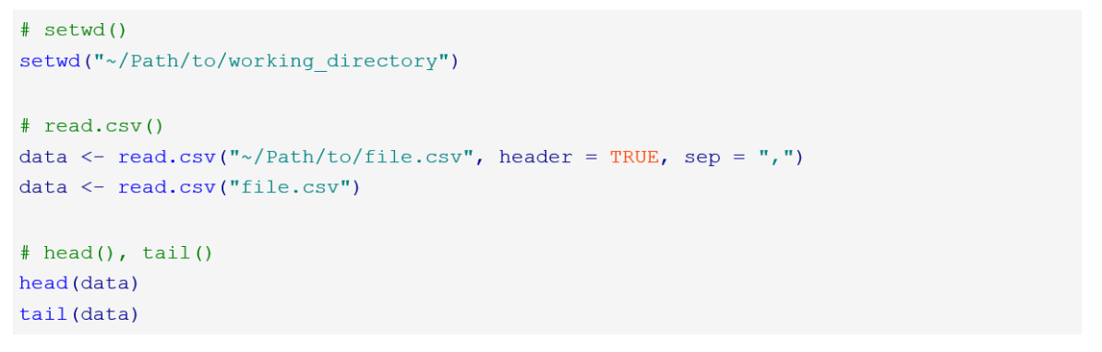
Functions to start with: Importing data and inspecting it

Slide 14
Break for excercise

